Slide 1


Advanced Analytics Lunch and Learn
June 2017

Slide 2






The Seattle Advanced Analytics Team
Janet Guerrero
Anthony Gould
Scott Henderson
Ben
Ahlvin
Tobias
Cortese
Dan
Tetrick
In Flight Work
T-Mobile Radio Frequency (RF) planning demand and capacity
Allrecipes Shopper Analytics- UPC matching and weather models
Power BI Product Team development support
Microsoft Office Insights- marketing attribution and lead gen
Leading External Training
R Server
Cortana Intelligence Suite (including Azure ML)
Intro to R and Power BI
Azure Analysis Services
Power BI Dashboard in a Day, DAX, Data Modeling

Slide 3
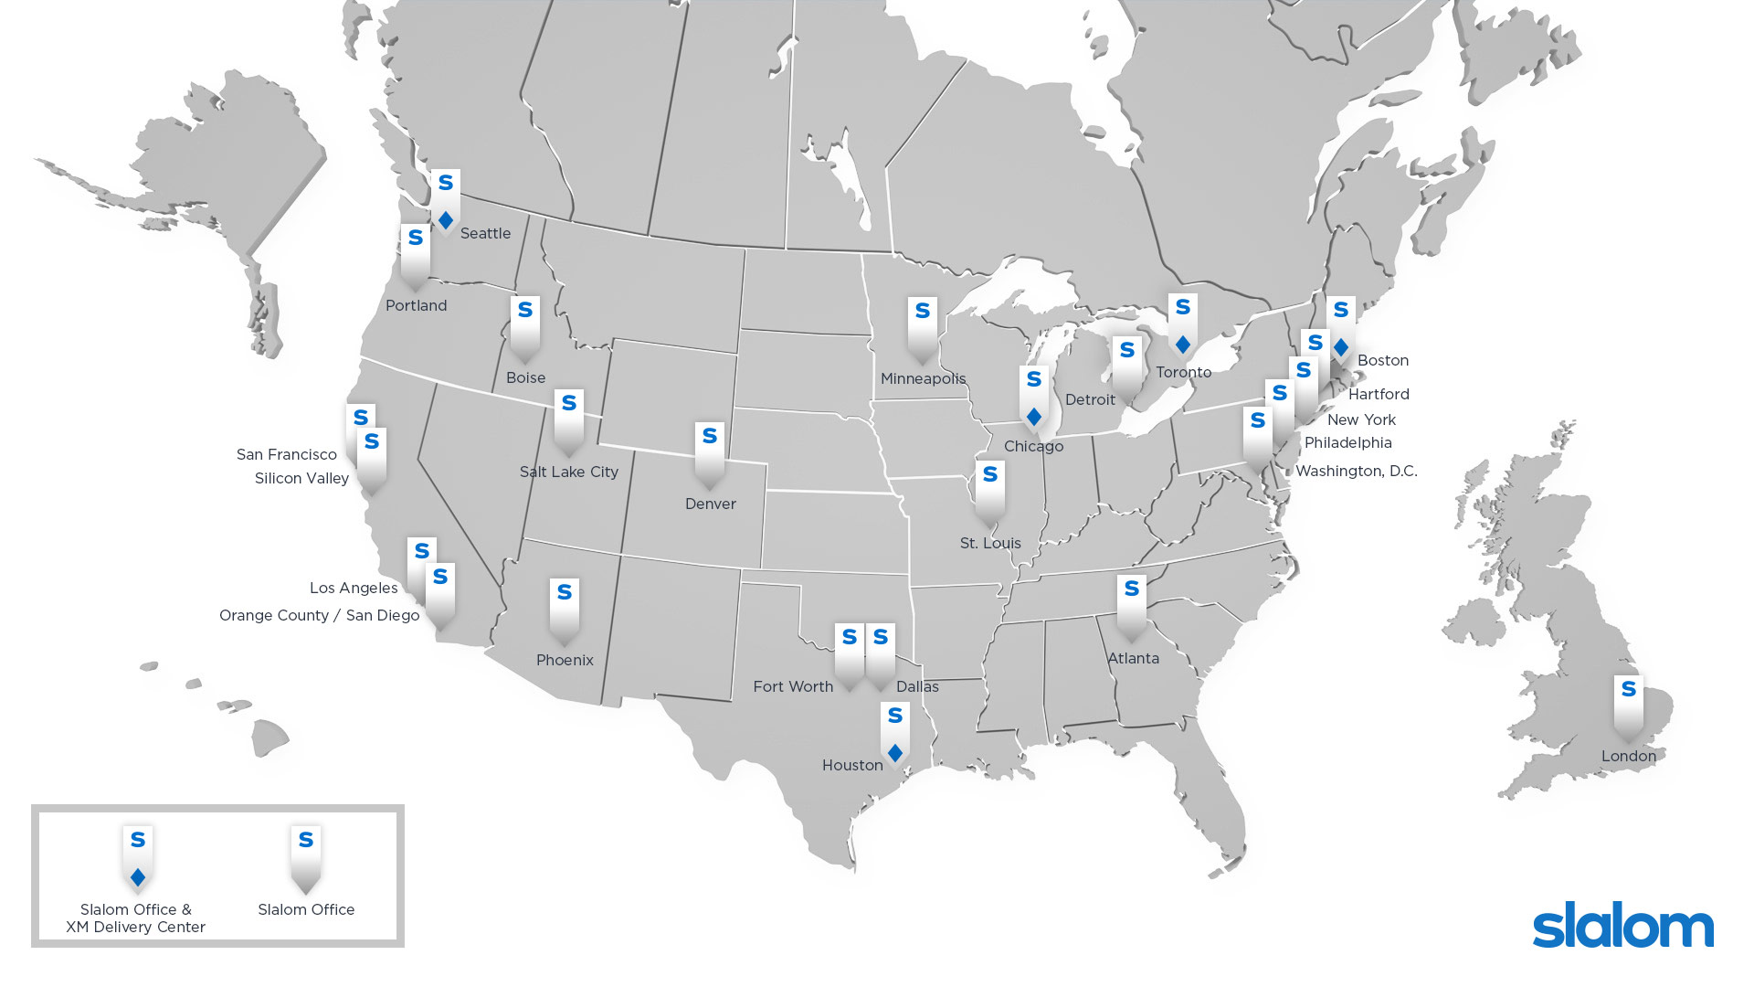





Luke Stanke
Anthony Gould
Marina Matovic
Saken Kulkarni
Austin Tidmore
Navneet Tuteja
Building Network
We want to thank these Slalom team members that have been fantastic support this year!

Slide 4

2017 United States Pollution Forecasting
Dan Tetrick - Data Scientist

Slide 5




INTRODUCTION – PROBLEM TASK
Create an accurate and actionable “BIG DATA” end-to-end solution leveraging R Programming, SQL Server 2016, and PowerBI against a publicly available US Pollution dataset.
Utilize the integration of R with the Microsoft data stack to display how the technologies work together to make data science tasks more efficient, powerful, and scalable.
Make the project available to the public as an example of machine learning with big data in the modern environment.

Slide 6

Meet Dan
After completing a 6 year enlistment as a Nuclear Missile Technician aboard submarines in the US Navy, Dan became a Learning Scientist where he develop RescuShell, the first all-virtual engineering course for a major university. His passion for statistics and computational modeling eventually led him into a career in predictive modeling. Here his first major accomplishment was providing statistical evidence to the federal government regarding the mortgage back security and appraisal fraud cases. Dan’s next major success was at Boeing where he helped them through their spare parts pricing transformation. He was responsible for creating their pricing models and optimization algorithms leading them to a market-based pricing strategy. Now he is a Slalom data scientist where he creates forecasting models for Microsoft’s Azure platform and conducts national training on Machine Learning and R programming.
Dan is an expert in R programming and his career interests include predictive modeling, distributed computation, and other highly analytical areas with problem-solving and consulting functionalities in nature. M.S., Education Psychology, University of Wisconsin-Madison B.S., Psychology (Neuroscience), University of Washington

Slide 7

What is
Language
Platform
Statistics programming language
Single-threaded
Data visualization tool
Data stored in-memory (RAM)
Open source
Focus on statistics and machine learning
Community
2.5+M users
Taught in most universities
New and recent grad’s use it
Thriving user groups worldwide
Ecosystem
10,000+ free algorithms in CRAN
Scalable to big data
Rich application & platform integration
Notes:
Slide objective
Establish that R is a language is as important for the community that uses it an the capabilities written to extend it than the language itself.
Talking points
Part 1 of the R World is The R language, developed specifically for data analysis – particularly among statisticians and mathematicians.
[optional points]:
Developed in New Zealand, release in roughly 2000.
Maintained by the R Foundation which releases new editions of R every few weeks.
Licensed under GPL open source license.
R directly supports complex data manipulation operations making them extremely simple for users, particularly those with greater depth in statistics and mathematics than in computer science.
Huge community of users across industry, government and academia use R daily.
There are R user groups in most major cities. Some of them very active and very large. Suggest that users look at MeetUp for local groups that meet regularly.
Most important to the value of R is the huge repository of freely exchanged, algorithms, techniques, scripts, adapters, techniques, training available.
Introduce CRAN: “The Comprehensive R Archive Network”.
Data access & integration
Data transformation
Data profiling
Data visualization
Predictive analytics
Machine Learning
CRAN contains over 7000 (and growing) contributed packages. Many algorithms, test data, comments on usage, etc. One package contains hundreds of algorithms packaged as a library.
All are designed to run with the R language.
CRAN is the largest but not the only. Thousands of additional algorithms, visualizations and tools are available from BioConductor, GitHub and other repositories.
Notes

Slide 8
Introducing Microsoft R Server
Linux, Windows, Hadoop & Teradata
High-performance, Scalable R
100% open source R
CRAN, Bioconductor, MRAN, GitHub compatibility
Big-data connectivity
Scalable analytics
Multi-platform
In-database, in-cluster scalability
Choice of IDE
R Server Technology
CRAN
Microsoft R Open
Remote Execution
Machine Learning
PEMA / ScaleR
HDInsight/SQL Integration
Open Source Components
Licensed Capabilities
Notes:
Microsoft R Server is a broadly deployable enterprise-class analytics platform based on R that is supported, scalable and secure. Supporting a variety of big data statistics, predictive modeling and machine learning capabilities, R Server supports the full range of analytics – exploration, analysis, visualization and modeling
Slide objective
Introduce the high –level value of R Server and R Services over other instantiations of the R language.
Talking points
R Server products provide an enhanced experience for the R User without loss of compatibility
R Server products are “open core” – the utilize the open source R product entirely and build new capabilities around that core without impacting compatibility.
Users of R Server products enjoy full compatibility with open source compatible with the entire (and vast) collection of algorithms, connectors, visualization tools shared openly via CRAN, Bioconductor and other shared resources like GitHub.
Key extensions enable R to tackle big data challenges that exceed the capacity of open source R.
R Scripts built for one platform using R Server can be easily run on another platform running R Server
We call it WODA – write once, deploy anywhere.
Two key contributions:
Build on any version of the product and deploy using other versions
Investment protection as platform choices change
Develop on the desktop and immediately deploy to RDBMS – SQL Server, EDW (SQL Server & Teradsata) or Hadoop (Microsoft, Cloudera, Hortonworks and MapR)
Notes

Slide 9
Microsoft R Server Extends Open-Source R:
Multi-threading
Matrix operations, linear algebra, and many other math operations run on all available cores on a CPU or cluster node.
Parallel processing
ScaleR functions utilize all available resources, local or distributed
On-disk data storage
RAM limitations lifted – Break Through Your Memory Barrier!

Slide 10
Microsoft R Server family
From Data To Action - On or Off Premises
Data Sources
People
Cortana Intelligence
+
Apps
Apps
Sensors and devices
Automated Systems
Microsoft R Server & SQL R Services
DATA
INTELLIGENCE
ACTION
Notes:
Slide Objective
Introduce the two product families and transition to high-level product overviews.
Talking Points
Microsoft brings two complementary product lines to bear on the challenges of Advanced Analytics.
Cortana Intelligence Suite provides a rich, end-to-end, cloud-based advanced analytics capability.
Microsoft’s R Server and SQL R Services products leverage a predominantly on-premises point of view – designed for users with significant investments in on-premises data, data repositories, and application portfolios.
Notes
Avoid being dragged into a direct comparison of the two products. There is not a clear answer until much more is known about the audience and their challenges.
If you get dragged into this discussion you may well lose the remainder of your time.

Slide 11
US Pollution Forecasting Model

Slide 12



US Pollution Forecasting Model
Download/Clone the project and all associated code and files from Dan Tetrick’s GIT hub page:
https://github.com/dantetrick/US-Pollution-R-Server-Demo
Download data from Kaggle – US Pollution data:
https://www.kaggle.com/sogun3/uspollution
To Create your own pollution dataset:
https://aqsdr1.epa.gov/aqsweb/aqstmp/airdata/download_files.html
Download R Programming (*NOTE – Open Source R)
https://cran.r-project.org/bin/windows/base/
Download R Studio (IDE)
https://www.rstudio.com/products/rstudio/download/

Slide 13
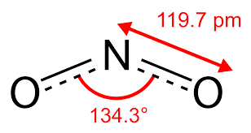
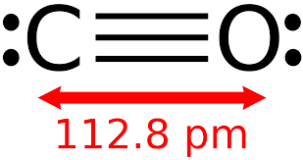
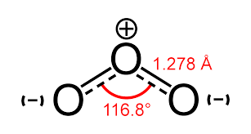
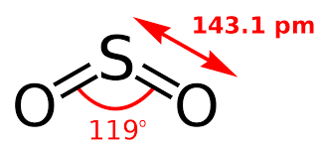
US Pollution Forecasting Model
Create daily pollution forecasts across 4 pollutants for June 1, 2016 – May 31, 2017 using historical data collected from Jan 1, 2000 – May 31, 2016.
NO2 – Nitrogen Dioxide
CO – Carbon Monoxide
O3 – Ozone Gas
SO2 – Sulfur Dioxide
Final data must be stored in SQL Server and the R model needs to be integrated into a scheduled SQL job so that it updates and re-scores new data without a staffed data scientist.
Ensure that the model results are up-to-date, actionable and presentable using PowerBI.

Slide 14
US Pollution Forecasting Model
At this point we will be shifting our attention to the R Script where we will focus the lesson on several code “chunks”.
Set Options, load libraries, set paths, source custom codes
Create 20 year Date Dimension data
Load and Clean 2000-2016 US Pollution Data
Create 2016-2017 US Pollution Projection Data
Create US Pollution Station Address Dimension
Create Xternal Data Frames (Xdf)
Exploratory Data Analysis with Xdf
Create Models
Predict Models onto Projections
Finalize Model Data
Load All Data to SQL
We will not be able to do a deep dive into each of the custom functions or the code itself do to time constraints. However, each of the functions are available and can be deconstructed for learning later.

Slide 15
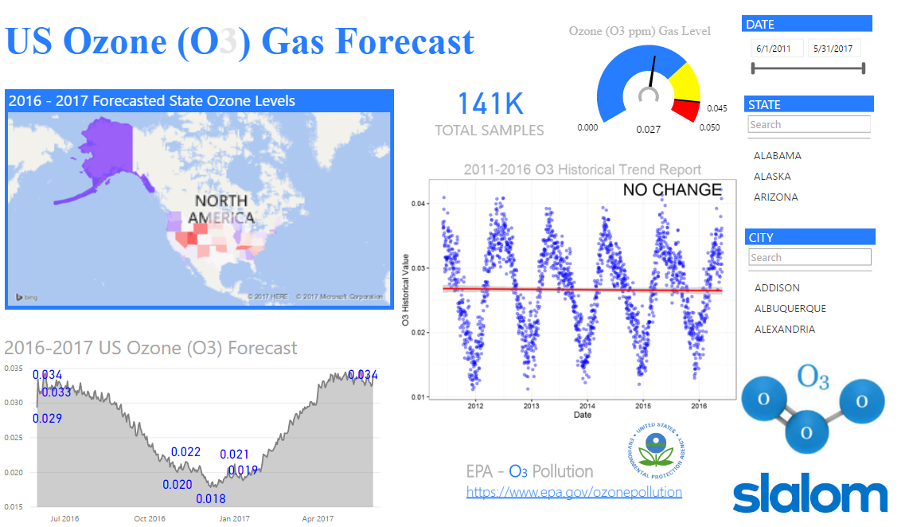
Report Results from SQL using PowerBI
Power BI reporting connects directly to the pollution tables created throughout the modeling process.
The reporting data model was created inside of PowerBI using basic DAX functions.
Custom R graphics are utilized as well hyperlink to more information regarding individual pollutants.
Custom PowerBI graphics from their gallery are also used to create a more informative, eye pleasing report.

